Slide 1
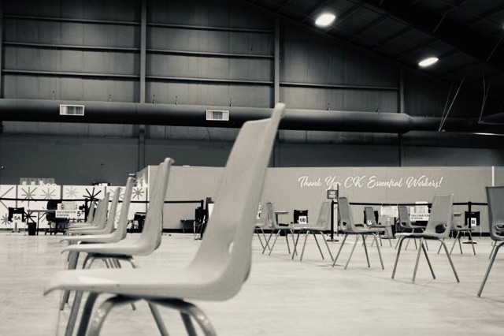
Social Story

Slide 2
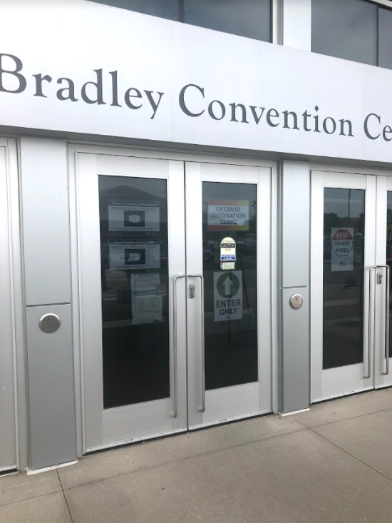
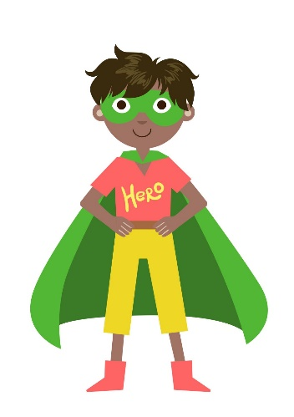
Get in line and enter when it is your turn.
Welcome to the Bradley Centre! This is the main
door.
You should wear a mask and sanitize your hands as you enter.

Slide 3
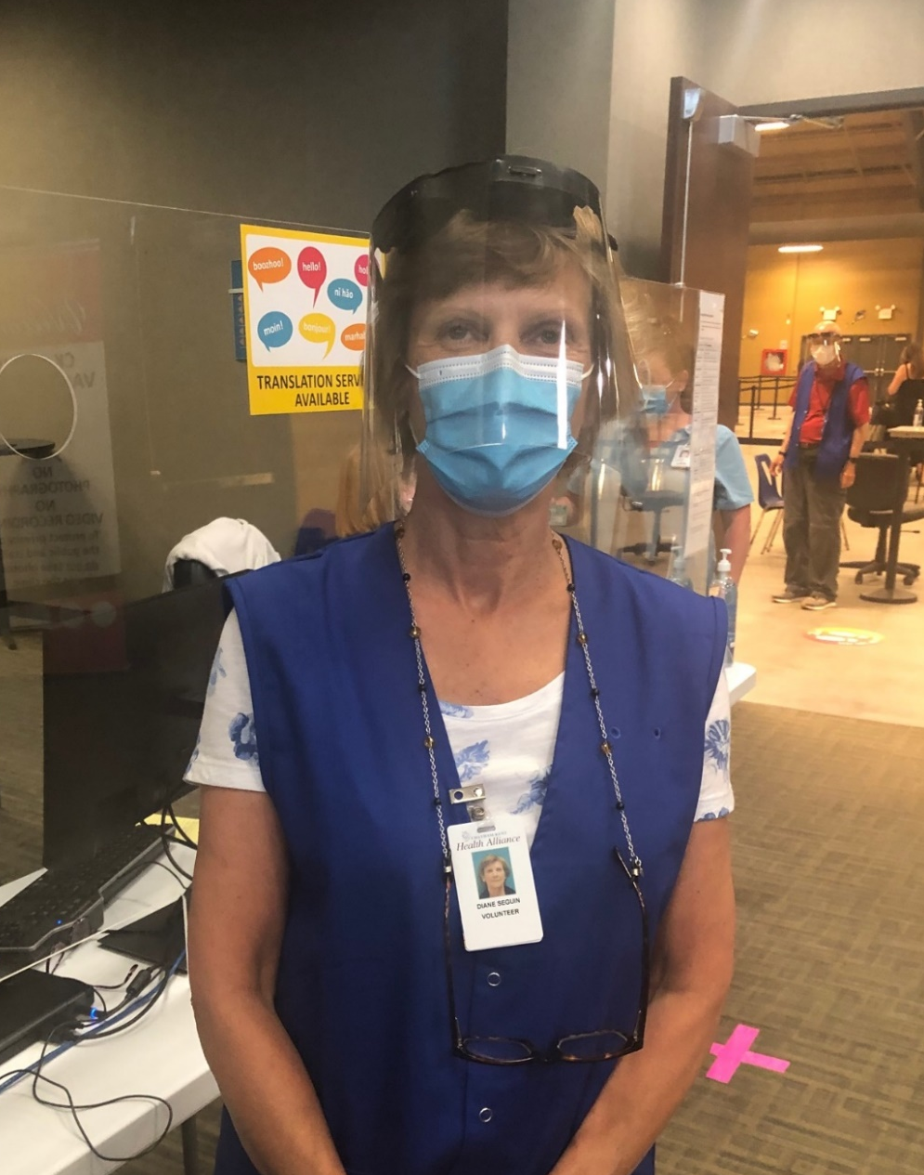
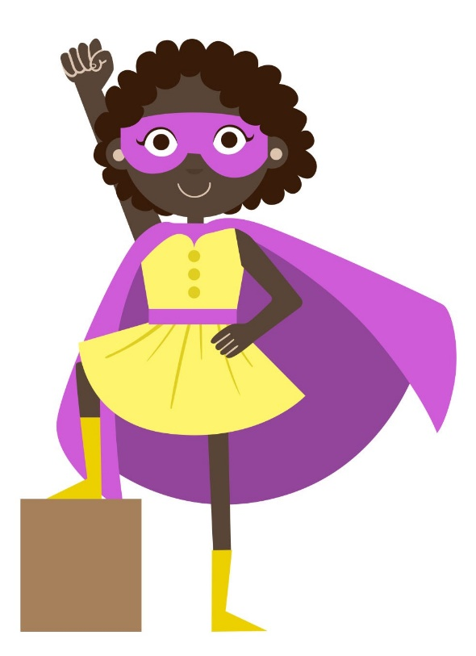
This area could be busy and loud at times. It’s exciting so many people are here to get vaccinated!
Check In
You will stand in line to be greeted by a volunteer in a blue vest.
They will send you to the check in desk where a worker will ask you some questions.

Slide 4
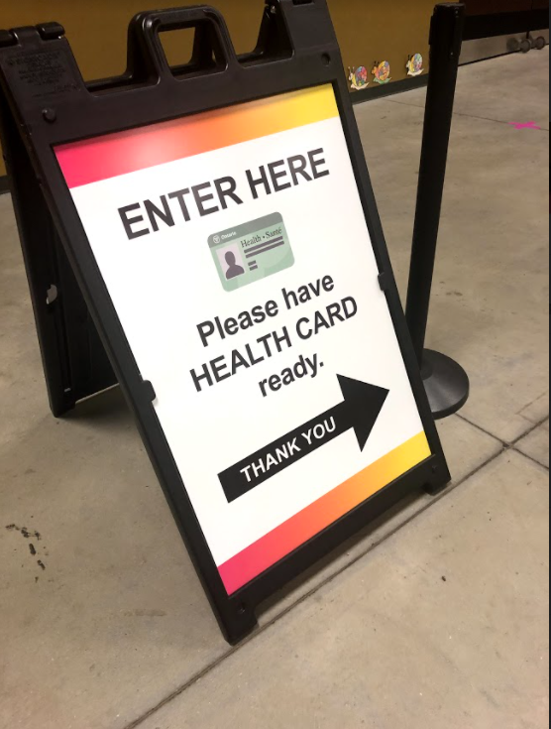
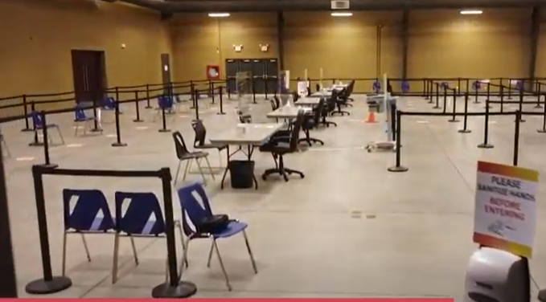
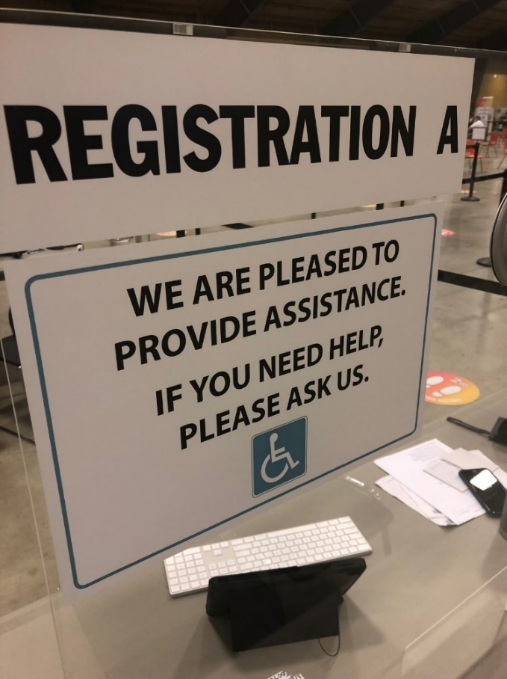
They will ask you questions and scan your health card.
Next, you will enter the lineup for the registration desks.
When it is your turn, a volunteer will tell you what desk to go to.

Slide 5
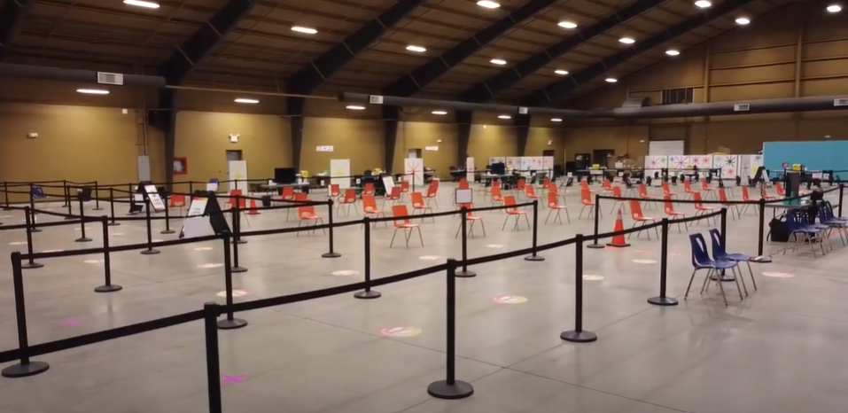
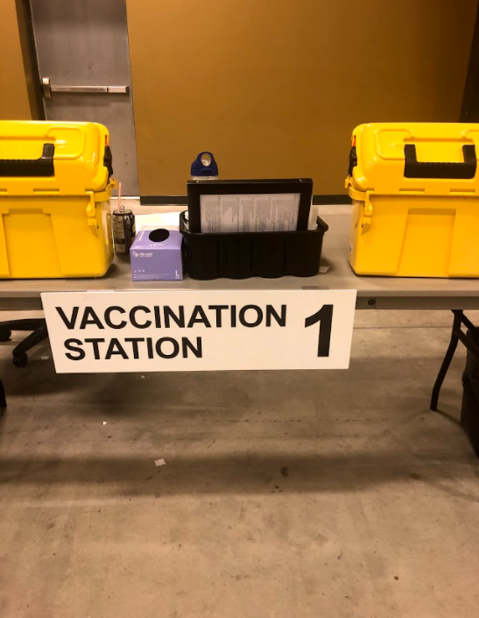
A volunteer will direct you to one of the tables when it is your turn.
There are 10 tables in total. You will have to walk across the large room.
It is now time to get vaccinated!

Slide 6
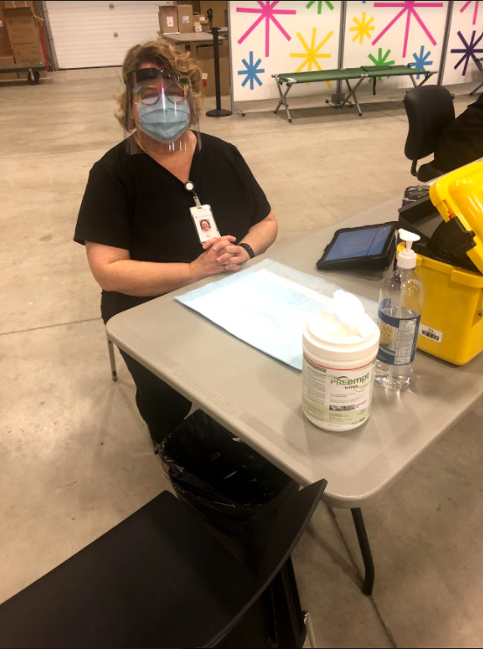
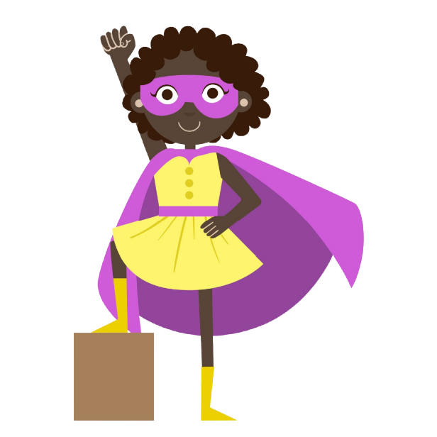
They will ask you questions about how you are feeling.
A nurse or paramedic will welcome you and ask you to sit down.
Hello!
How are you feeling today?
They may be wearing a black vest, or even a uniform. Many will wear masks and face shields.

Slide 7
It is ok to feel scared or nervous.
You can tell the nurse or paramedic and they can help you.
You can distract yourself by reading a book, listening to music or by closing your eyes and taking deep breaths. It may help to look away from the nurse when you are getting your vaccine.

Slide 8
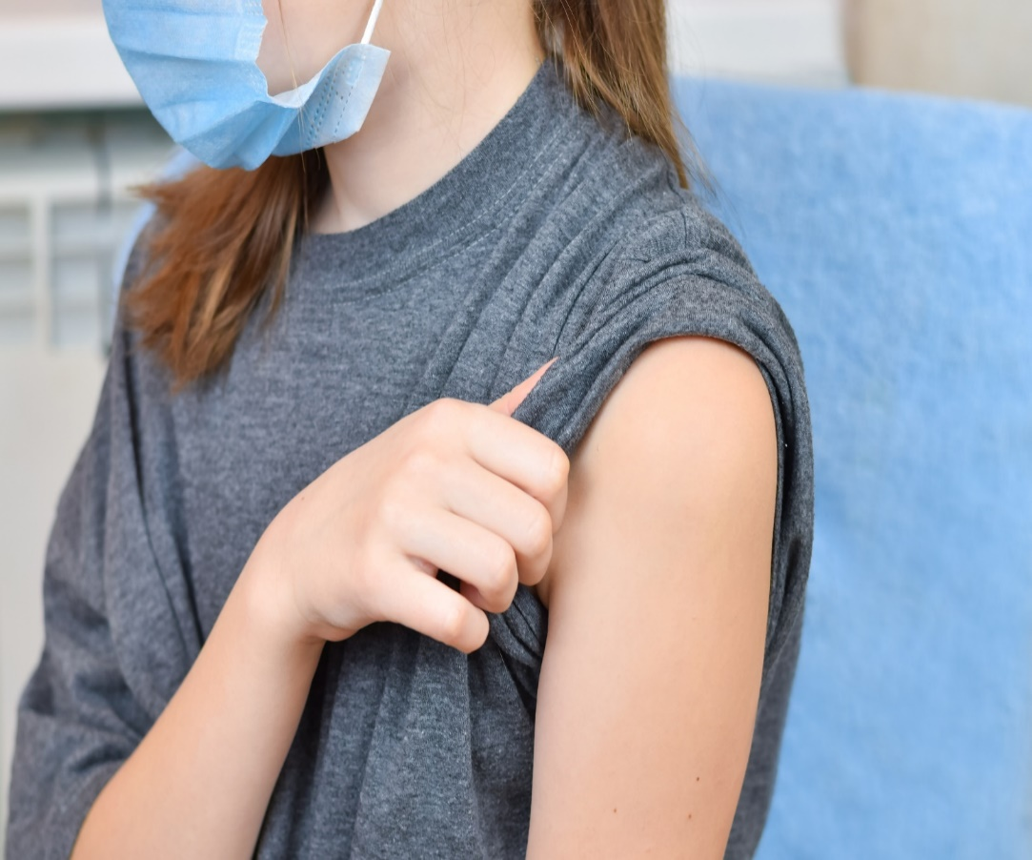
A cold wet wipe will clean your arm before you get your needle.
The needle goes into your arm. You will need to roll up your sleeve.

Slide 9
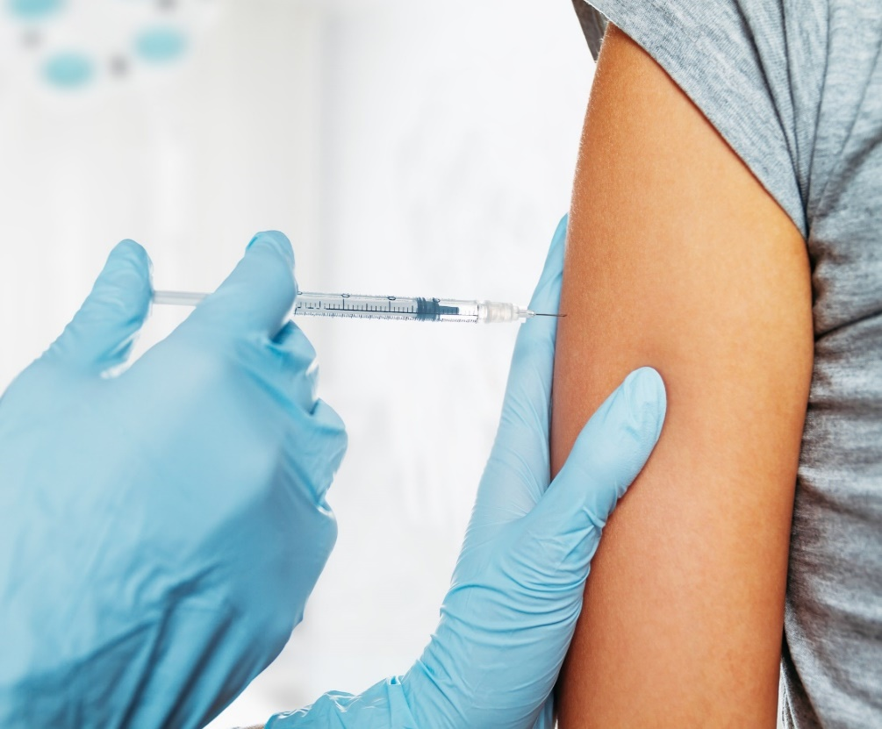
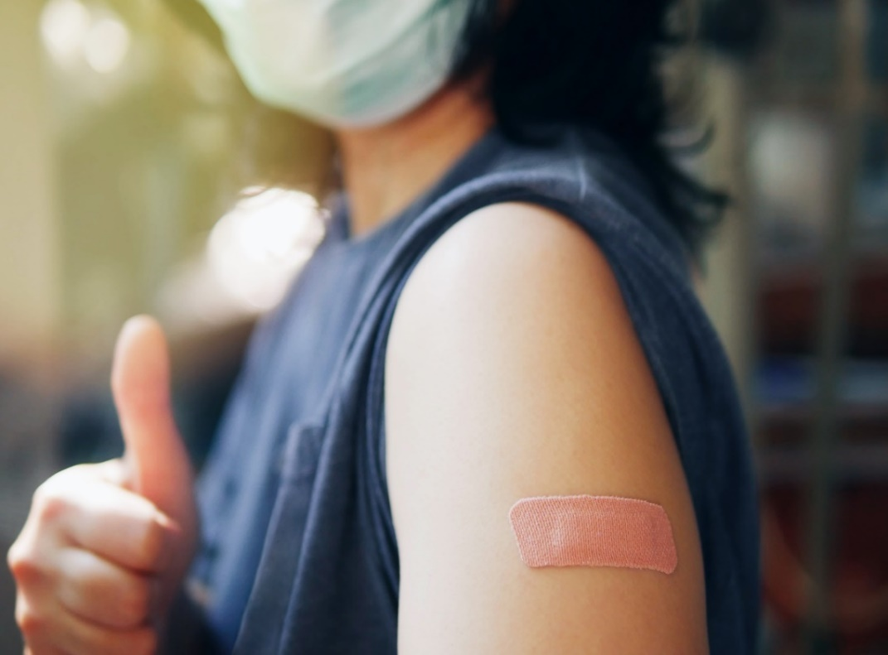
They will put on a band aid and you can roll down your sleeve.
You may feel a pinch getting the needle. It will only last a few
seconds.
Remember to sit still.
You may get a sticker!

Slide 10
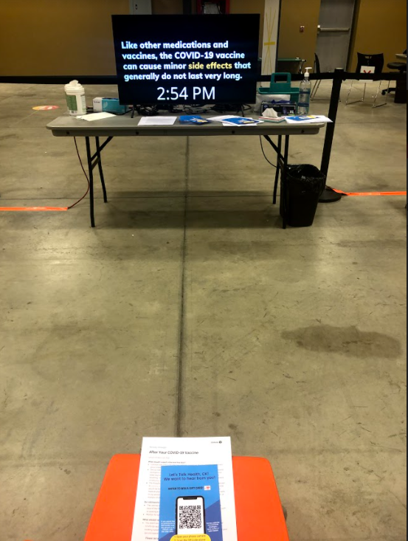
Waiting can be hard for everyone. You can listen to your music (with headphones), read your book, or talk to the person you came with to pass the time.
After your needle you will have to wait in the orange chairs for 15 minutes.
Someone will come and ask you how you are doing.

Slide 11
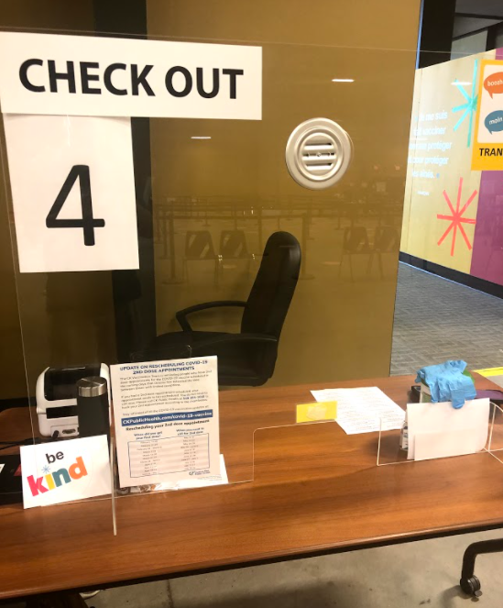
They will tell you when it’s time to come back for a second needle in 8 weeks. You might have to line up again.
Time to go! After 15 minutes go to the check out desk and get a print out.

Slide 12
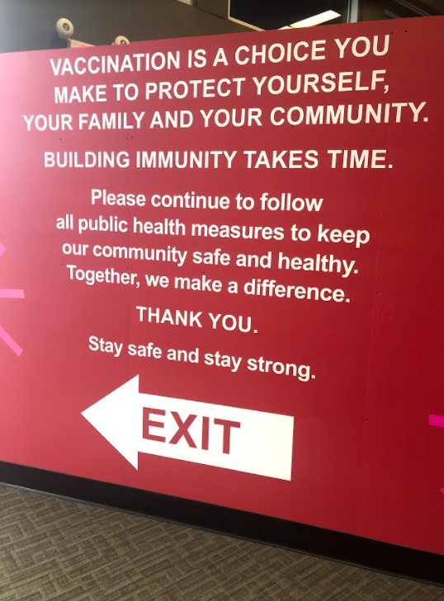
Follow the red exit sign to leave the building. You will be asked to sanitize your hands when leaving.
Great job today!

Slide 13
How to use this social story:
This social story is available for download as a Powerpoint document and is designed to be adapted and personalized as caregivers see fit to match the needs and literacy levels of the individual it is written for.
The procedures outlined in the social story are general in nature and may shift or adapt depending on clinic dates and time of day.
Should you require additional supports please instruct a volunteer on arrival or during the booking process and we will do whatever we can to ensure your visit is a successful one.

