Slide 1
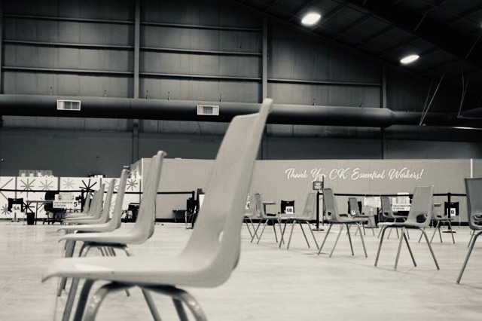
Social Story
Getting my COVID-19 vaccine

Slide 2
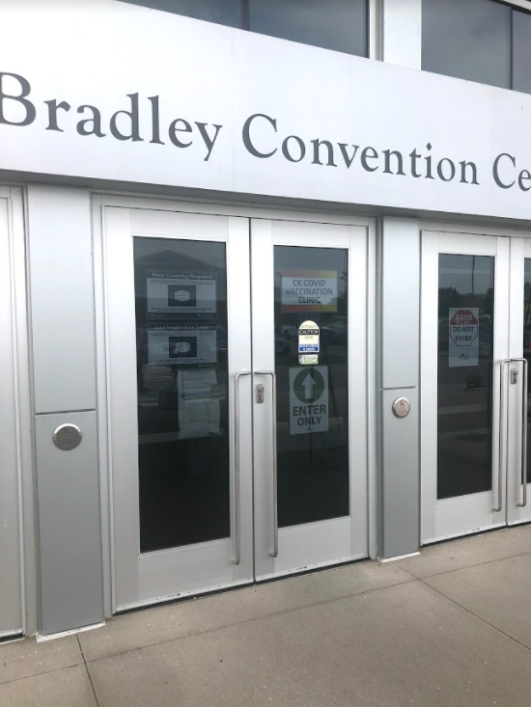
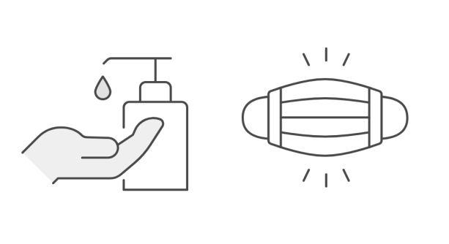
Welcome to the Bradley Centre. This is the main door. Get in line and enter when it is your turn.
You may need to wear a mask and
sanitize your hands as you enter.

Slide 3
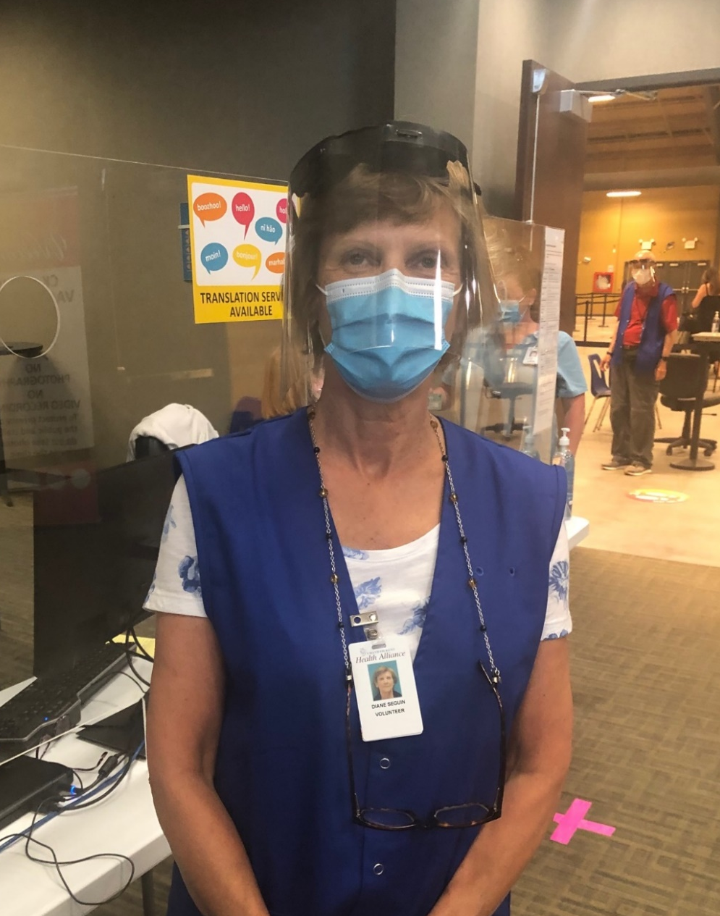
You will stand in line to be greeted by a volunteer in a blue vest. They will send you to the check in desk where a worker will ask you some questions. This area could be busy and loud at times. It’s exciting so many people are here to get vaccinated.
Check In

Slide 4
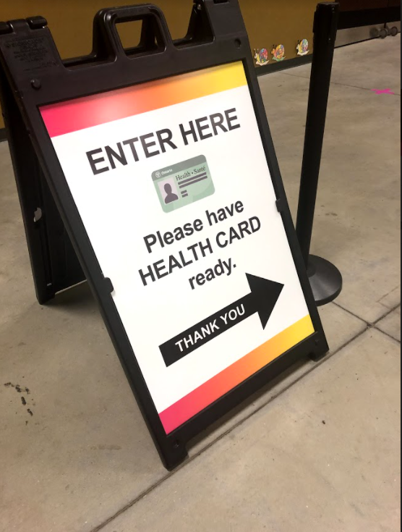
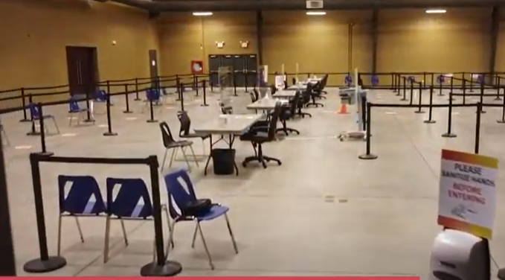
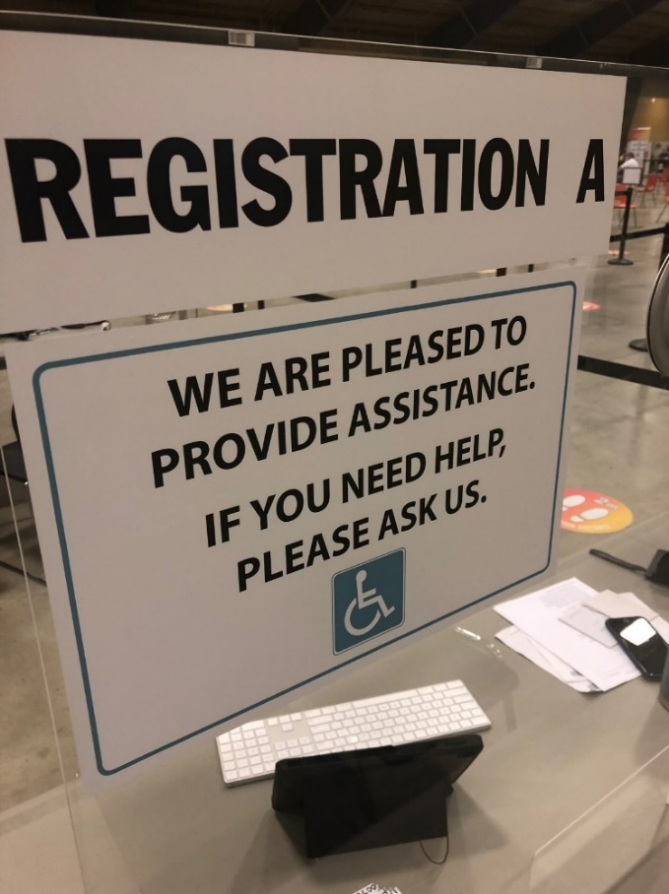
Next, you will enter the lineup for the registration desks. When it is your turn, a volunteer will tell you what desk to go to. They will ask you questions and scan your health card.

Slide 5
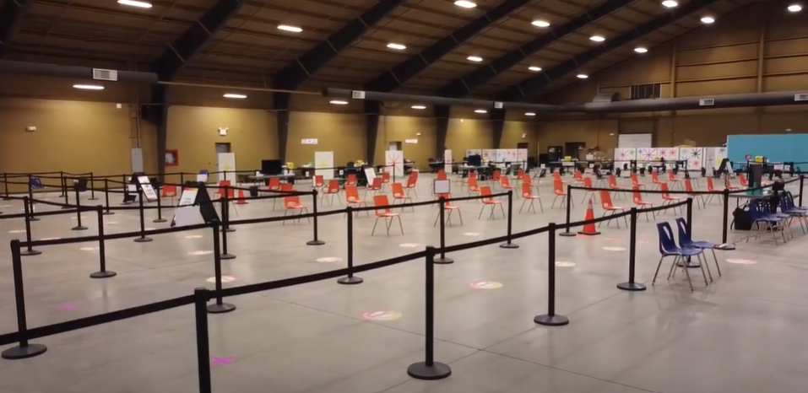
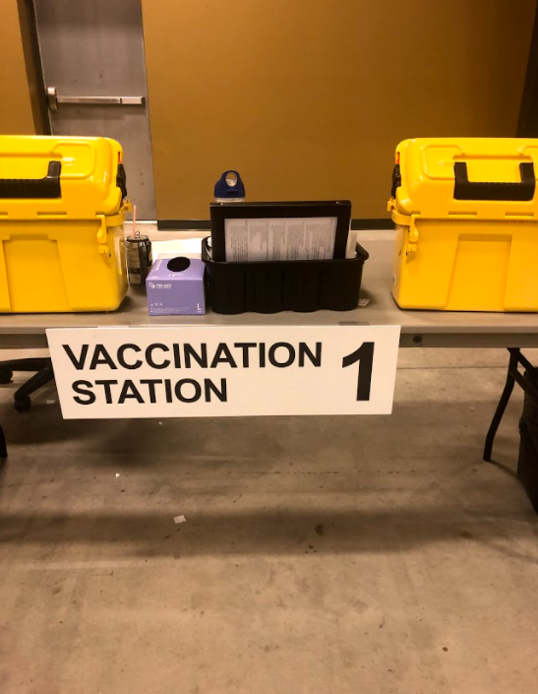
It is now time to get vaccinated! A volunteer will direct you to one of the tables when it is your turn. There are 10 tables in total. You will have to walk across the large room.

Slide 6
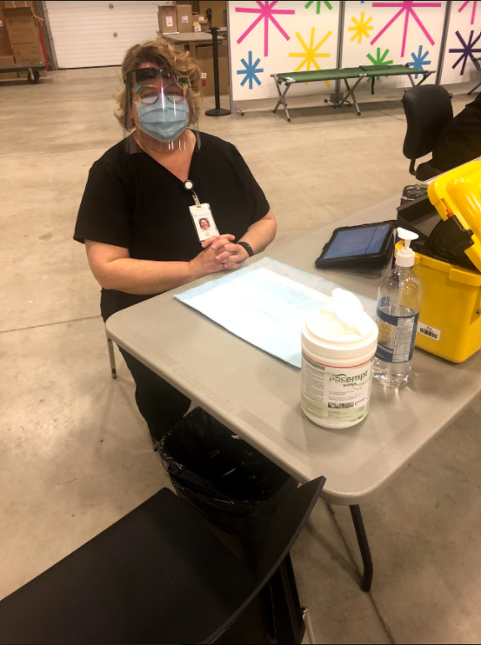
A nurse or paramedic will welcome you and ask you to sit down. They may be wearing a black vest, or even a uniform. Many will wear masks and face shields. They will ask you questions about how you are feeling.

Slide 7
It is ok to feel scared or nervous. You can tell the nurse or paramedic and they can help you. You can distract yourself by reading a book, listening to music or by closing your eyes and taking deep breaths. It may help to look away from the nurse when you are getting your shot

Slide 8
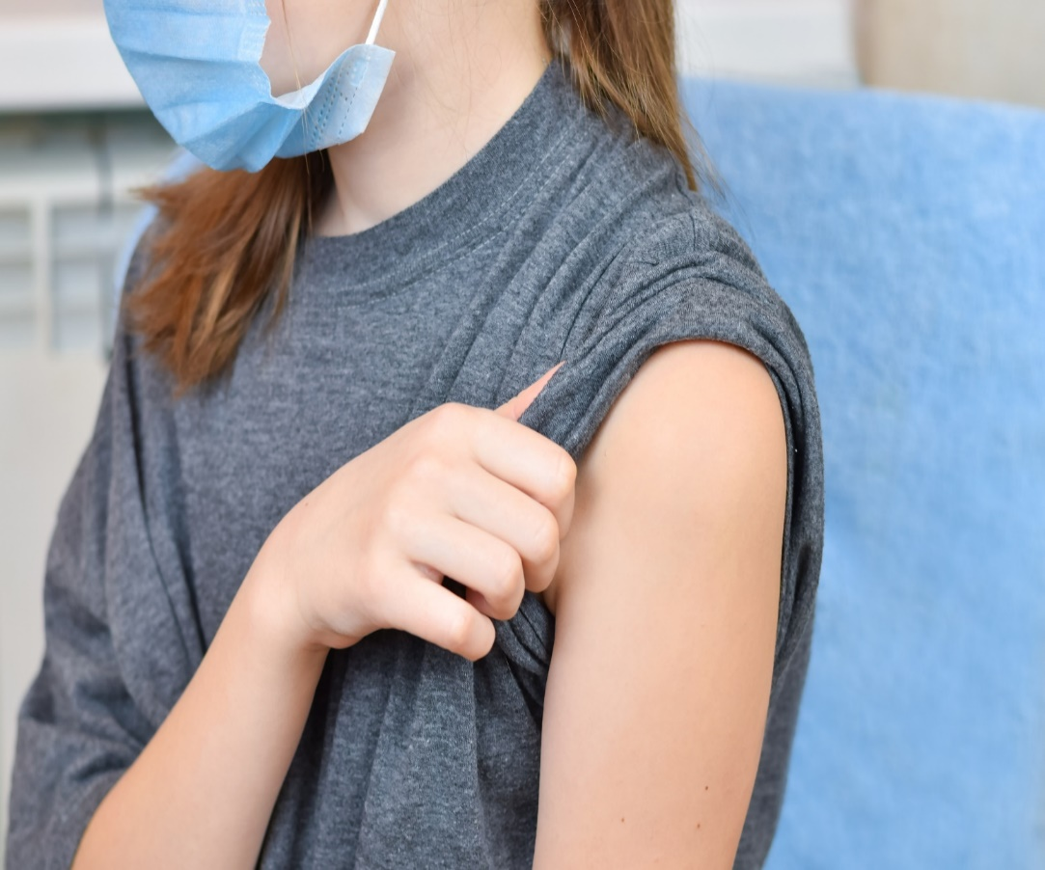
A cold wet wipe will clean your arm before you get your needle.
The needle goes into your arm. You will need to rollup your sleeve.

Slide 9
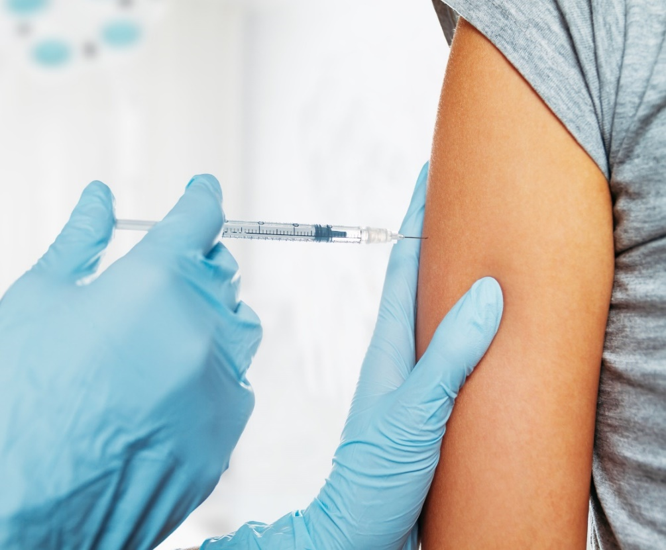
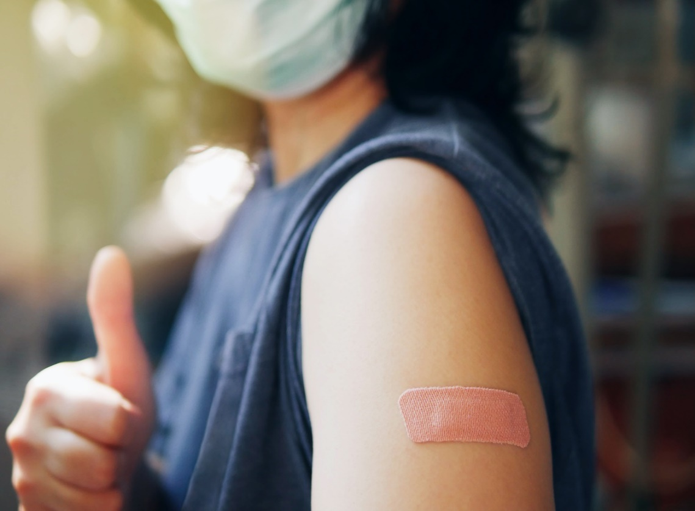
You did it! Great job. They will put on a band aid and you can roll down your sleeve. You may get a sticker!
You may feel a pinch getting the needle. It will only last a few
seconds. Remember to sit still.

Slide 10
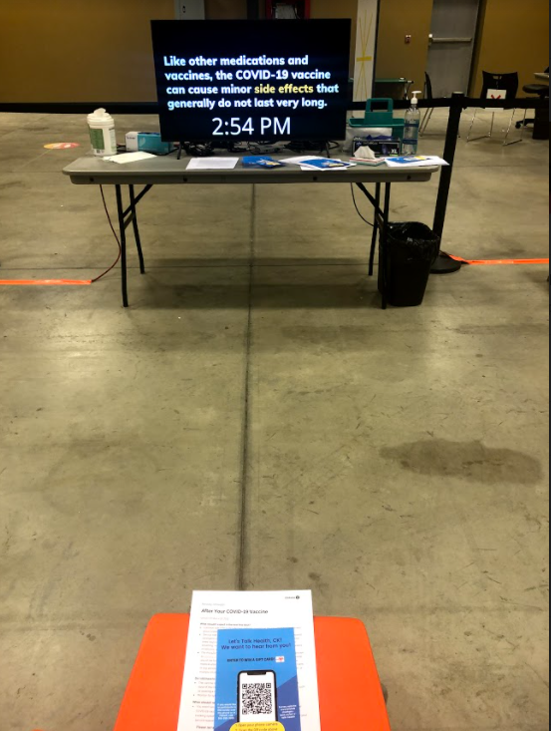
After your needle you will have to wait in the orange chairs for 15 minutes. Someone will come and ask you how you are doing. Waiting can be hard for everyone. You can listen to your music (with headphones), read your book, or talk to the person you came with to pass the time.

Slide 11
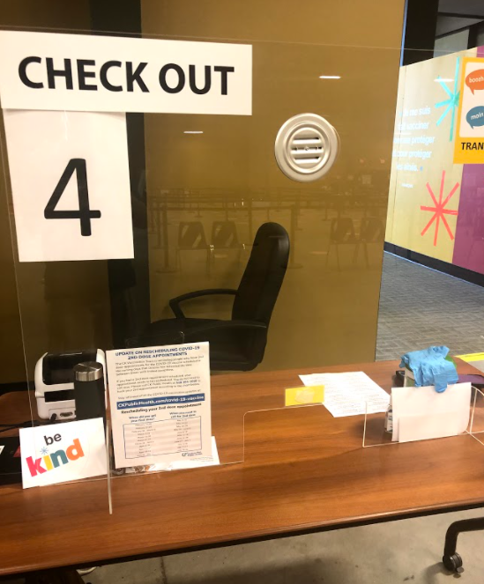
Time to go! After 15 minutes go to the check out desk and get a print out. They will tell you when it’s time to come back for a second needle in 16 weeks. You might have to line up again.

Slide 12
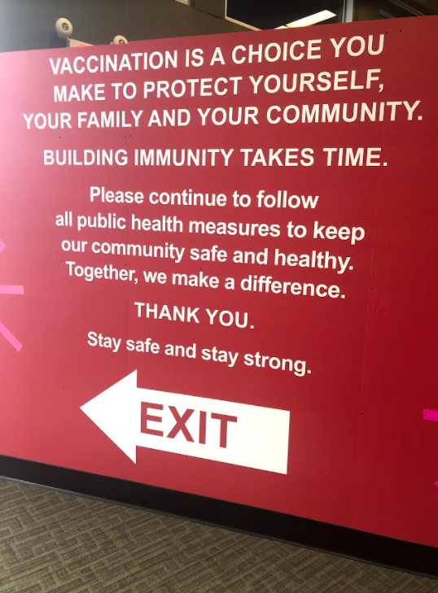
You are all done! Follow the red exit sign to leave the building. Great job today! You will be asked to sanitize your hands when leaving.

Slide 13
How to use this social story:
This social story is available for download as a Powerpoint document and is designed to be adapted and personalized as caregivers see fit to match the needs and literacy levels of the individual it is written for.
The procedures outlined in the social story are general in nature and may shift or adapt depending on clinic dates and time of day.
Should you require additional supports please instruct a volunteer on arrival or during the booking process and we will do whatever we can to ensure your visit is a successful one.

